Slide 1
Quadrilateral Angles
From nRich Strange Rectangle
384

Slide 2




Quadrilateral Angles
$$C \left(1,5\right)$$
(Not to scale)
$$B \left(7,3\right)$$
$$\left(0,2\right) D$$
$$A \left(1,0\right)$$
Determine the angles in the quadrilateral.

Slide 3






Quadrilateral Angles
$$C \left(1,5\right)$$
(Not to scale)
$$\sqrt{2^{2}+{\left(−6\right)}^{2}}=2\sqrt{10}$$
$$\sqrt{3^{2}+1^{2}}=\sqrt{10}$$
$$5$$
$$B \left(7,3\right)$$
$$5\sqrt{2}$$
$$\left(0,2\right) D$$
$$\sqrt{3^{2}+6^{2}}=3\sqrt{5}$$
$$\sqrt{2^{2}+{\left(−1\right)}^{2}}=\sqrt{5}$$
$$A \left(1,0\right)$$
You could start by determining all the lengths.

Slide 4



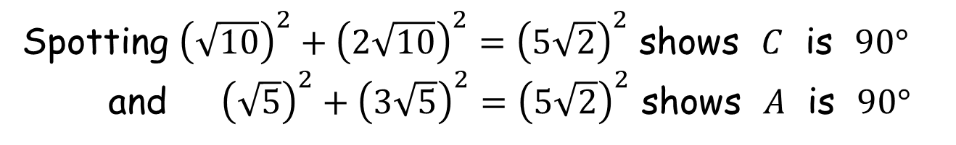

Quadrilateral Angles
$$C \left(1,5\right)$$
$$2\sqrt{10}$$
$$\sqrt{10}$$
$$5$$
$$B \left(7,3\right)$$
$$5\sqrt{2}$$
$$\left(0,2\right) D$$
$$3\sqrt{5}$$
$$\sqrt{5}$$
$$A \left(1,0\right)$$
Spotting ${\left(\sqrt{10}\right)}^{2}+{\left(2\sqrt{10}\right)}^{2}={\left(5\sqrt{2}\right)}^{2}$ shows $C$ is $90°$
and ${\left(\sqrt{5}\right)}^{2}+{\left(3\sqrt{5}\right)}^{2}={\left(5\sqrt{2}\right)}^{2}$ shows $A$ is $90°$

Slide 5
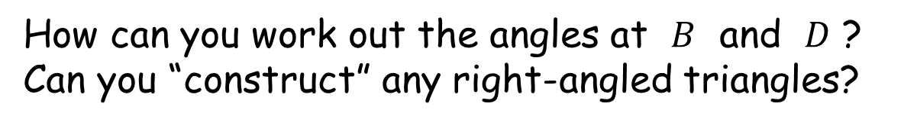

Quadrilateral Angles
$$C \left(1,5\right)$$
$$2\sqrt{10}$$
$$\sqrt{10}$$
$$B \left(7,3\right)$$
$$E$$
$$\left(0,2\right) D$$
$$3\sqrt{5}$$
$$\sqrt{5}$$
$$A \left(1,0\right)$$
How can you work out the angles at $B$ and $D$ ?
Can you “construct” any right-angled triangles?

Slide 6
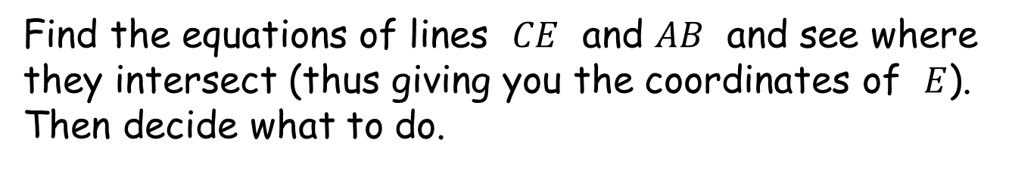
Quadrilateral Angles
$$C \left(1,5\right)$$
$$2\sqrt{10}$$
$$\sqrt{10}$$
$$B \left(7,3\right)$$
$$E$$
$$\left(0,2\right) D$$
$$3\sqrt{5}$$
$$\sqrt{5}$$
$$A \left(1,0\right)$$
Find the equations of lines $CE$ and $AB$ and see where they intersect (thus giving you the coordinates of $E$).
Then decide what to do.

Slide 7

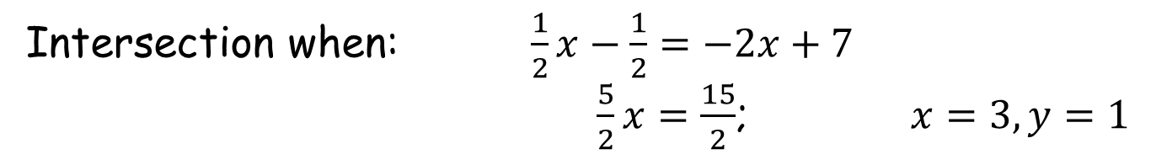
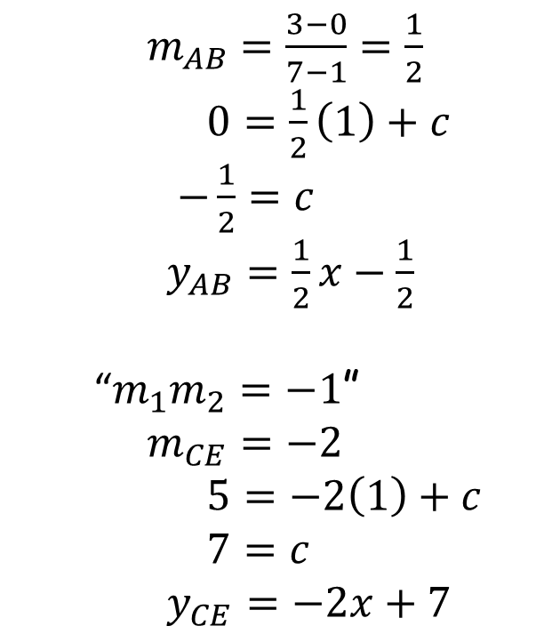
Quadrilateral Angles
$m_{AB}=\frac{3−0}{7−1}=\frac{1}{2}$
$0=\frac{1}{2}\left(1\right)+c$
$−\frac{1}{2}=c$
$y_{AB}=\frac{1}{2}x−\frac{1}{2}$
“$m_{1}m_{2}=−1$”
$m_{CE}=−2$
$5=−2\left(1\right)+c$
$7=c$
$y_{CE}=−2x+7$
$$C \left(1,5\right)$$
$$B \left(7,3\right)$$
$$E$$
$$\left(3,1\right)$$
$$A \left(1,0\right)$$
Intersection when: $\frac{1}{2}x−\frac{1}{2}=−2x+7$
$\frac{5}{2}x=\frac{15}{2}$; $x=3, y=1$

Slide 8

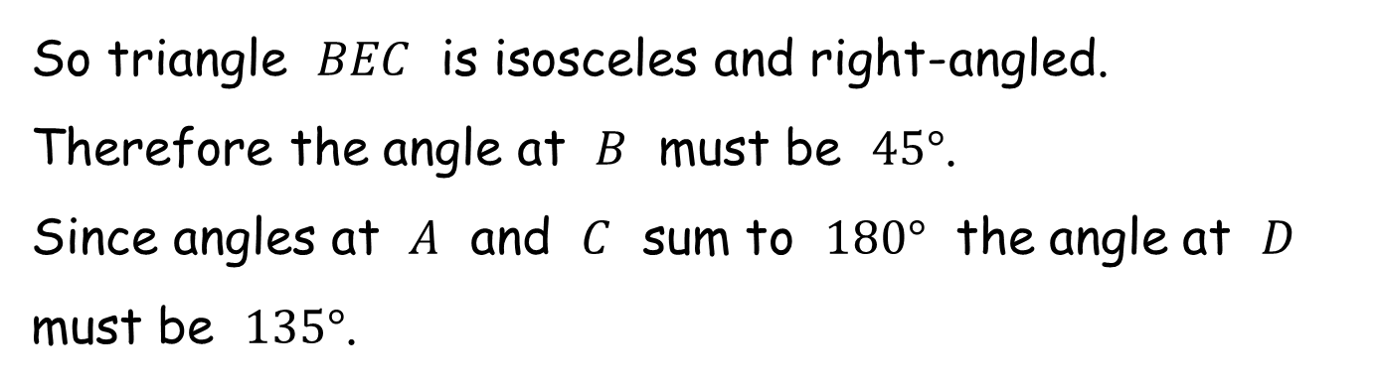

Quadrilateral Angles
$$C \left(1,5\right)$$
$$2\sqrt{10}$$
$$\sqrt{4^{2}+{\left(−2\right)}^{2}}=\sqrt{20}$$
$$B \left(7,3\right)$$
$$\sqrt{2^{2}+4^{2}}=\sqrt{20}$$
$$E$$
$$\left(3,1\right)$$
So triangle $BEC$ is isosceles and right-angled.
Therefore the angle at $B$ must be $45°$.
Since angles at $A$ and $C$ sum to $180°$ the angle at $D$ must be $135°$.

Slide 9
Quadrilateral Angles
$$C \left(1,5\right)$$
$$2\sqrt{10}$$
$$\sqrt{4^{2}+{\left(−2\right)}^{2}}=\sqrt{20}$$
$$B \left(7,3\right)$$
$$\sqrt{2^{2}+4^{2}}=\sqrt{20}$$
$$E$$
$$\left(3,1\right)$$
Note: we got a lucky break. If the triangle wasn’t isosceles then we would have had to resort to more advanced trigonometry.

Slide 10


Quadrilateral Angles
$$C \left(1,5\right)$$
(Not to scale)
$$B \left(7,3\right)$$
$$45°$$
$$\left(0,2\right) D$$
$$135°$$
$$A \left(1,0\right)$$
Determine the angles in the quadrilateral.

Slide 12
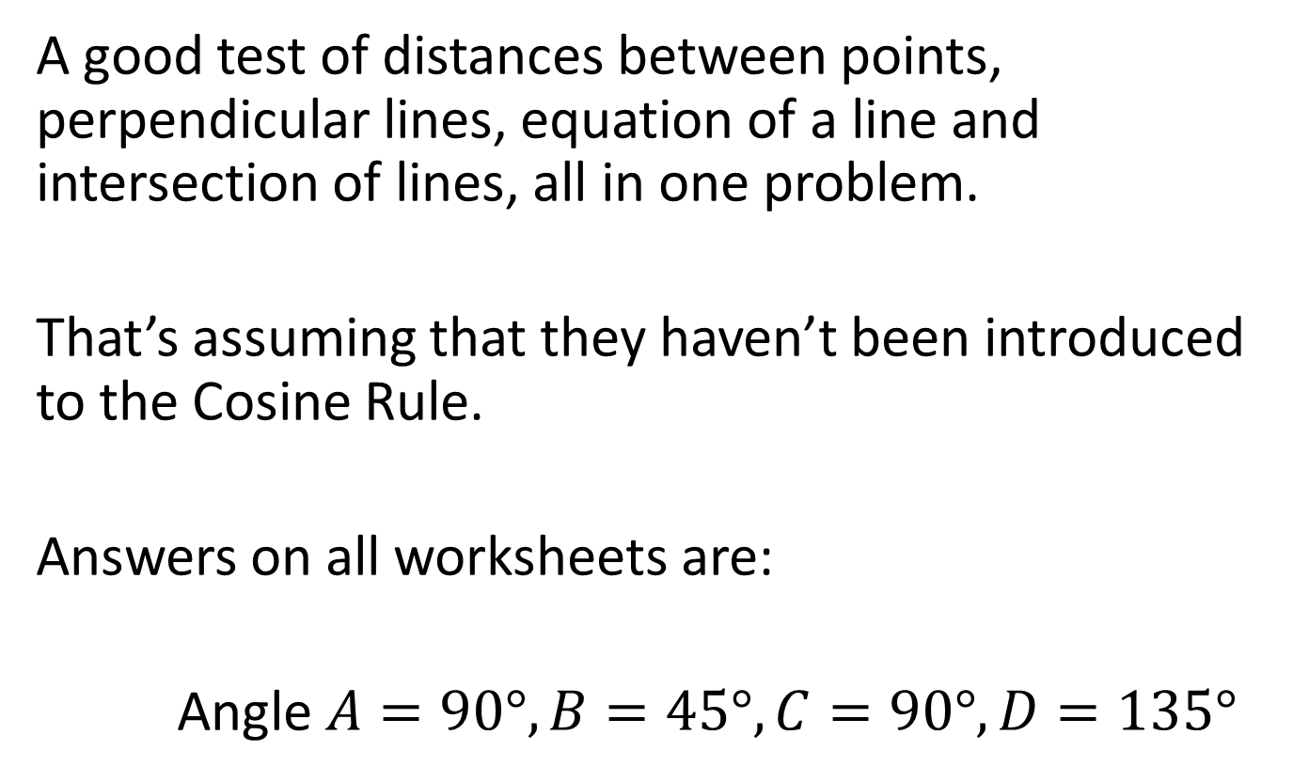
Note to Teacher
A good test of distances between points, perpendicular lines, equation of a line and intersection of lines, all in one problem.
That’s assuming that they haven’t been introduced to the Cosine Rule.
Answers on all worksheets are:
Angle $A=90°, B=45°, C=90°, D=135°$

Slide 13
RESOURCES

Slide 14




Quadrilateral Angles
SIC_86
$$C \left(8,40\right)$$
(Not to scale)
$$B \left(56,24\right)$$
$$\left(0,16\right) D$$
$$A \left(8,0\right)$$
A
Determine the angles in the quadrilateral.
Notes:
X=6, y=2

Slide 15




Quadrilateral Angles
SIC_86
$$C \left(2,10\right)$$
(Not to scale)
$$B \left(14,6\right)$$
$$\left(0,4\right) D$$
$$A \left(2,0\right)$$
B
Determine the angles in the quadrilateral.
Notes:
X=3, y=1

Slide 16




Quadrilateral Angles
SIC_86
$$C \left(3,17\right)$$
(Not to scale)
$$B \left(23,12\right)$$
$$\left(0,5\right) D$$
$$A \left(3,0\right)$$
C
Determine the angles in the quadrilateral.
Notes:
X=4, y=1

Slide 17



Quadrilateral Angles
SIC_86
$$C \left(2,13\right)$$
(Not to scale)
$$B \left(17,10\right)$$
$$\left(0,3\right) D$$
$$A \left(2,0\right)$$
D
Determine the angles in the quadrilateral.
Notes:
X=3, y=2

Slide 18




Quadrilateral Angles
SIC_86
$$C \left(12,65\right)$$
(Not to scale)
$$B \left(89,44\right)$$
$$\left(0,21\right) D$$
$$A \left(12,0\right)$$
E
Determine the angles in the quadrilateral.
Notes:
X=7, y=4

Slide 19




Quadrilateral Angles
SIC_86
$$C \left(4,20\right)$$
(Not to scale)
$$B \left(28,12\right)$$
$$\left(0,8\right) D$$
$$A \left(4,0\right)$$
F
Determine the angles in the quadrilateral.
Notes:
X=4, y=2

Slide 20



Quadrilateral Angles
SIC_86
$$C \left(6,50\right)$$
(Not to scale)
$$B \left(62,42\right)$$
$$\left(0,8\right) D$$
$$A \left(6,0\right)$$
G
Determine the angles in the quadrilateral.
Notes:
X=7, y=4

Slide 21


Quadrilateral Angles
SIC_86
$$C \left(3,25\right)$$
(Not to scale)
$$B \left(31,21\right)$$
$$\left(0,4\right) D$$
$$A \left(3,0\right)$$
H
Determine the angles in the quadrilateral.
Notes:
X=4, y=3

Slide 22



Quadrilateral Angles
SIC_86
$$C \left(4,26\right)$$
(Not to scale)
$$B \left(34,20\right)$$
$$\left(0,6\right) D$$
$$A \left(4,0\right)$$
I
Determine the angles in the quadrilateral.
Notes:
X=5, y=1

Slide 23



Quadrilateral Angles
SIC_86
$$C \left(6,29\right)$$
(Not to scale)
$$B \left(41,15\right)$$
$$\left(0,14\right) D$$
$$A \left(6,0\right)$$
J
Determine the angles in the quadrilateral.
Notes:
X=5, y=2

Slide 24



Quadrilateral Angles
SIC_86
$$C \left(6,34\right)$$
(Not to scale)
$$B \left(46,24\right)$$
$$\left(0,10\right) D$$
$$A \left(6,0\right)$$
K
Determine the angles in the quadrilateral.
Notes:
X=5, y=3

Slide 25


Quadrilateral Angles
SIC_86
$$C \left(4,41\right)$$
(Not to scale)
$$B \left(49,36\right)$$
$$\left(0,5\right) D$$
$$A \left(4,0\right)$$
L
Determine the angles in the quadrilateral.
Notes:
X=5, y=4

Slide 26
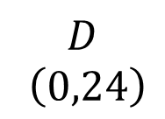

Quadrilateral Angles
SIC_86
$$C \left(8,40\right)$$
(Not to scale)
$$D$$
$$\left(0,24\right)$$
$$B \left(56,16\right)$$
$$A \left(8,0\right)$$
M
Determine the angles in the quadrilateral.
Notes:
X=6, y=2

Slide 27
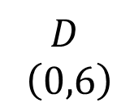

Quadrilateral Angles
SIC_86
$$C \left(2,10\right)$$
(Not to scale)
$$D$$
$$\left(0,6\right)$$
$$B \left(14,4\right)$$
$$A \left(2,0\right)$$
N
Determine the angles in the quadrilateral.
Notes:
X=3, y=1

Slide 28
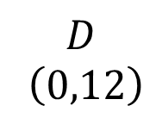

Quadrilateral Angles
SIC_86
$$C \left(3,17\right)$$
(Not to scale)
$$D$$
$$\left(0,12\right)$$
$$B \left(23,5\right)$$
$$A \left(3,0\right)$$
O
Determine the angles in the quadrilateral.
Notes:
X=4, y=1

Slide 29
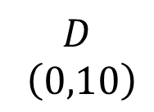

Quadrilateral Angles
SIC_86
$$C \left(2,13\right)$$
(Not to scale)
$$D$$
$$\left(0,10\right)$$
$$B \left(17,3\right)$$
$$A \left(2,0\right)$$
P
Determine the angles in the quadrilateral.
Notes:
X=3, y=2

Slide 30
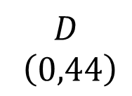

Quadrilateral Angles
SIC_86
$$C \left(12,65\right)$$
(Not to scale)
$$D$$
$$\left(0,44\right)$$
$$B \left(89,21\right)$$
$$A \left(12,0\right)$$
Q
Determine the angles in the quadrilateral.
Notes:
X=7, y=4

Slide 31
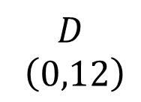

Quadrilateral Angles
SIC_86
$$C \left(4,20\right)$$
(Not to scale)
$$D$$
$$\left(0,12\right)$$
$$B \left(28,8\right)$$
$$A \left(4,0\right)$$
R
Determine the angles in the quadrilateral.
Notes:
X=4, y=2

Slide 32
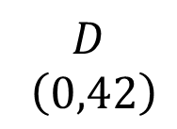

Quadrilateral Angles
SIC_86
$$C \left(6,50\right)$$
(Not to scale)
$$D$$
$$\left(0,42\right)$$
$$B \left(62,8\right)$$
$$A \left(6,0\right)$$
S
Determine the angles in the quadrilateral.
Notes:
X=7, y=4

Slide 33
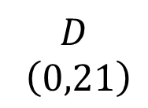

Quadrilateral Angles
SIC_86
$$C \left(3,25\right)$$
(Not to scale)
$$D$$
$$\left(0,21\right)$$
$$B \left(31,4\right)$$
$$A \left(3,0\right)$$
T
Determine the angles in the quadrilateral.
Notes:
X=4, y=3

Slide 34
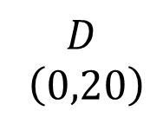

Quadrilateral Angles
SIC_86
$$C \left(4,26\right)$$
(Not to scale)
$$D$$
$$\left(0,20\right)$$
$$B \left(34,6\right)$$
$$A \left(4,0\right)$$
U
Determine the angles in the quadrilateral.
Notes:
X=5, y=1

Slide 35
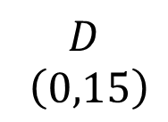

Quadrilateral Angles
SIC_86
$$C \left(6,29\right)$$
(Not to scale)
$$D$$
$$\left(0,15\right)$$
$$B \left(41,14\right)$$
$$A \left(6,0\right)$$
V
Determine the angles in the quadrilateral.
Notes:
X=5, y=2

Slide 36
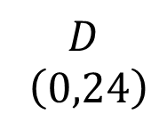

Quadrilateral Angles
SIC_86
$$C \left(6,34\right)$$
(Not to scale)
$$D$$
$$\left(0,24\right)$$
$$B \left(46,10\right)$$
$$A \left(6,0\right)$$
W
Determine the angles in the quadrilateral.
Notes:
X=5, y=3

Slide 37
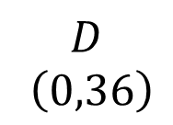

Quadrilateral Angles
SIC_86
$$C \left(4,41\right)$$
(Not to scale)
$$D$$
$$\left(0,36\right)$$
$$B \left(49,5\right)$$
$$A \left(4,0\right)$$
X
Determine the angles in the quadrilateral.
Notes:
X=5, y=4

